Slide 1
Solving Problems By Searching
Instructor: Dr. Wei Ding

Slide 2
Problem-Solving Agent
Goal-based agents: considering future actions and the desirability of their outcomes.
Decide what to do by finding sequences of actions that lead to desirable states.
Uninformed search algorithms: given no information about the problem other than its definition.
Informed search algorithms: have some idea of where to look for solutions.
Notes:
This lecture uses concepts from the analysis of algorithms.

Slide 3
Computer scientists face the task of comparing algorithms to see how fast they run or how much memory they require.
Let’s talk math…

Slide 4
Mathematical Background
Review Slide
Complexity analysis and O() notation.
Comparing algorithms to see how fast they run or how much memory they require.
Benchmarking: running the algorithms on a computer and measuring speed in seconds and memory consumption in bytes. ☹
Asymptotic analysis: a mathematical analysis of algorithms, independently of the particular implementation and input.

Slide 5
Example: Complexity Function T()
Review Slide
Not O() notation yet
Function SUMMATION(sequence) returns a number
Sum ← 0
For i← 1 to LENGTH(sequence)
sum ← sum+sequence[i]
Return sum
1
2 n = (1+1) *n
1
+
T(n) = 2n + 2,
where n is the size of sequence input

Slide 6
Asymptotic Analysis O()
Review Slide
The O() notation gives us an asymptotic analysis
For example, as n asymptotically approaches infinity, an O(n) algorithm is better than an O(n²) algorithm.
The O() notation abstracts over constant factors, which makes it easier to use, but less precise, than the T() notation.
For example, an O(n²) algorithm will always be worse than an O(n) in the long run, but if the two algorithms are T(n²+1) and T(100n+1000), then the O(n²) algorithm is actually better for n<= 110.

Slide 7
O() is a Good Compromise
Review Slide
The O() notation abstracts over both the exact number of operation (by ignoring the constant factor) and the exact content of the input (by consider only its size n)
Mathematically feasible
A good compromise between precision and ease of analysis

Slide 8
Limitation of O()
Review Slide
The O() notation discusses about the efficiency of a particular algorithm.
O() does not explain whether there could be a better algorithm for the problem at hand.
The first gross division is between problems that can be solved in polynomial and the problems that cannot be solved in polynomial time, no matter what algorithm is used.
P, NP, NP-Hard, NP-complete, co-NP, co-NP-complete.

Slide 9
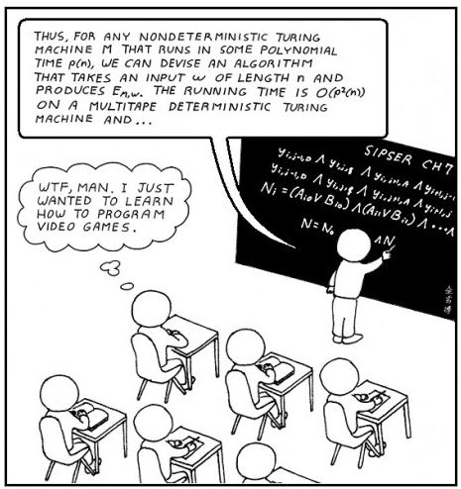
Courtesy of http://www.lolroflmao.com/wp-content/uploads/2011/09/computer-science-major.jpg

Slide 10
NP and Inherently Hard Problem
Review Slide
Problems can be solved in polynomial time
O(n^{k})
“easy” problem: O(log n) or O(n¹⁰⁰⁰), etc.
NP, the class of nondeterministic polynomial problems.
NP-complete refers to the hardest problems in the class NP. It has been proven that either all the NP-complete problems are in P or none of them is.

Slide 11
Halting problem
Review Slide
For example, in pseudocode, the program:
while (true) continue;
does not halt; rather, it goes on forever in an infinite loop. On the other hand, the program
print “Hello, world!”
halts very quickly.
One approach to the problem might be to run the program for some number of steps and check if it halts. But if the program does not halt, it is unknown whether the program will eventually halt or run forever.
Turing proved there cannot exist an algorithm which will always correctly decide whether, for a given arbitrary program and its input, the program halts when run with that input; the essence of Turing's proof is that any such algorithm can be made to contradict itself, and therefore cannot be correct.

Slide 12
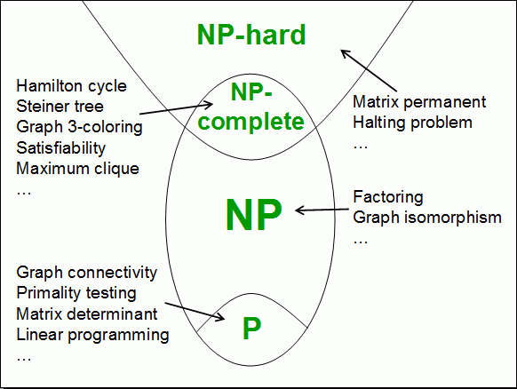
Review Slide
P = NP or P!= NP? Not yet proved.
Notes:
NP-HARD, A set or property of computational search problems (generally: all construction problems of corresponding NP-complete decision problems are NP-hard) A problem is NP-hard if solving it in polynomial time would make it possible to solve all problems in class NP in polynomial time. Some NP-hard problems are also in NP (these are called "NP-complete"), some are not. If you could reduce an NP problem to an NP-hard problem and then solve it in polynomial time, you could solve all NP problems. Also, there are decision problems in NP-hard but are not NP-complete, such as the infamous halting problem

Slide 13
Back to Problem Solving Agent
Problem formulation usually requires abstracting away real-world details to define a state space that can feasibly be explored.

Slide 14
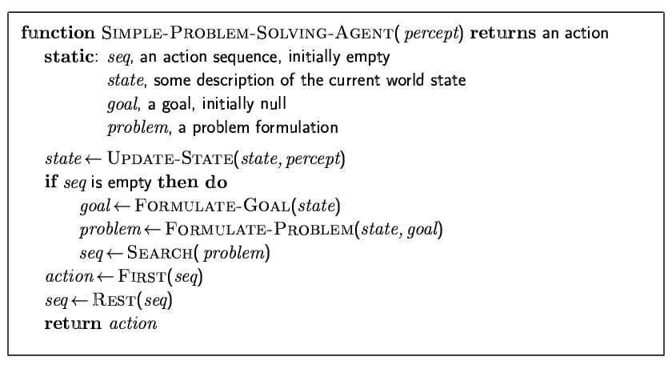
A Simple Problem-Solving Agent
Formulate → Search → Execution
Notes:
Problem formulation is the process of deciding what actions and states to consider, given a goal

Slide 15
Example: Romania
On holiday in Romania; currently in Arad, getting to Bucharest Formulate goal: be in Bucharest Formulate problem:
states: various cities
actions: drive between cities
Find solution:
sequence of cities, e.g., Arad, Sibiu, Fagaras, Bucharest

Slide 16
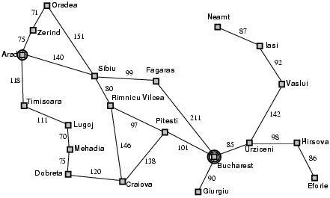
Example: Romania

Slide 17
Search
An agent with several immediate options of unknown value can decide what to do by first examining different possible sequences of actions that lead to states of known value, and then choosing the best sequence.

Slide 18
Problem Types
Deterministic, fully observable → single-state problem
Agent knows exactly which state is will be in; solution is a sequence
Non-observable → sensorless problem (conformant problem)
Agent may have no idea where it is; solution is a sequence
Nondeterministic and/or partially observable →contingency problem
Percepts provide new information about current state
Often interleave search, execution
Unknown state space → exploration problem

Slide 19
Single-state problem formulation
A problem is defined by four items:
Initial state e.g., “in Arad”
Actions of successor function S(x)= set of action-state pairs, S(Arad)={<Arad→Zerind, Zerind>, …}
Goal test, can be x=“in Bucharest”
Path cost (additive), Sum of distances, number of actions execute, etc.
A solution is a sequence of actions leading from the initial state to a goal state

Slide 20
A vacuum-cleaner world with just two locations
Three actions: Left, Right, Suck
A room can be clean or dirty
Questions: what are the total # of states?
(Tips: location of the vacuum cleaner, clean/dirty room, # of rooms)

Slide 21
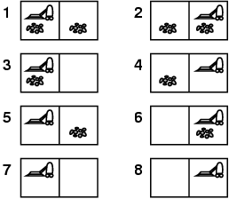
Example: vacuum world
Three actions: Left, Right, Suck
Single-state (deterministic), start in #5.
Solution? [Right, Suck]

Slide 22
Example: vacuum world
Sensorless (conformant problem)
start in {1,2,3,4,5,6,7,8 e.g., right goes to {2,4,6,8}
Solution? [Right, Suck, Left, Suck]

Slide 23
Example: vacuum world
Contingency
Partially observable: location, dirt at current location.
Percept: [L, Clean]
Start in #5 or #7
Solution? [Right, if dirt then Suck]

Slide 24
For the time being, we work on
Deterministic, fully observable → single-state problem

Slide 25
Example: vacuum world
States: the agent is in one of two locations, each of which might or might not contain dirt.
Initial state: any state.
Successor function: successor function generates the legal states that result from trying the three actions (Left, Right, and Suck).
Goal test: checks whether all the squares are clean.
Path cost: Each step costs 1, the # of steps in the path.
Why 8 states?
2 * 2²

Slide 26
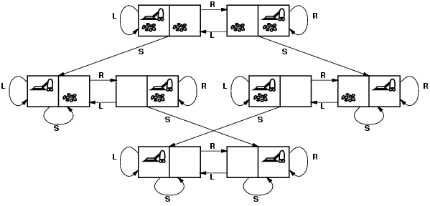
Vacuum world state space graph
An optimal solution has the lowest path cost among all solutions.

Slide 27
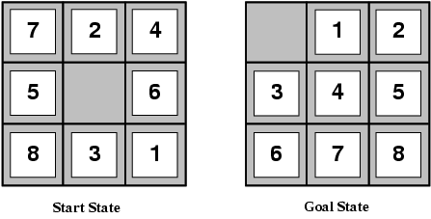
Example: The 8-puzzle
States?
Actions?
Goal test?
Path cost?

Slide 28
Example: The 8-puzzle
States: locations of tiles
Actions: move blank left, right, up, down
Goal test: = goal state (given)
Path cost: 1 per move
Notes:
The 8-puzzle has 9!/2 = 181440 reachable states

Slide 29
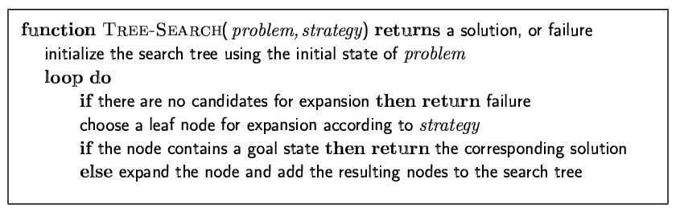
Tree search algorithms
Basic idea: offline, simulated exploration of state space by generating successors of already-explored states (a.k.a.~expanding states)
The essence of search – following up one option now and putting the others aside for later, in case the first choice does not lead to a solution.

Slide 30
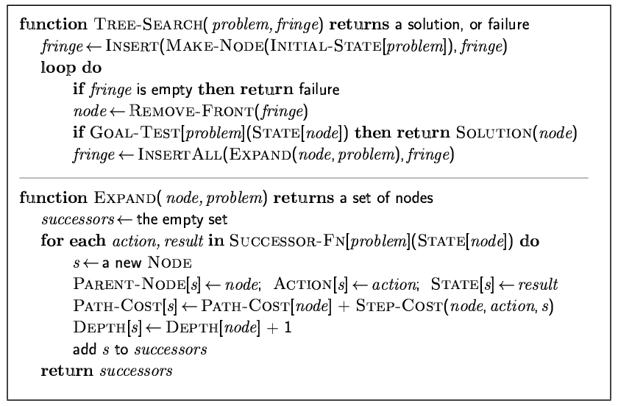
Implementation: general tree search

Slide 31
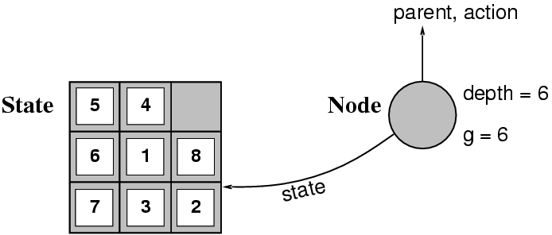
Implementation: states vs. nodes
A state is a (representation of) a physical configuration
A node is a data structure constituting part of a search tree includes state, parent node, action, path cost g(x), depth
The Expand function creates new nodes, filling in the various fields and using the SuccessorFn of the problem to create the corresponding states.

Slide 32
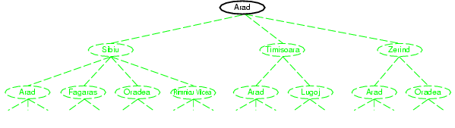
Tree search example: the initial state

Slide 33
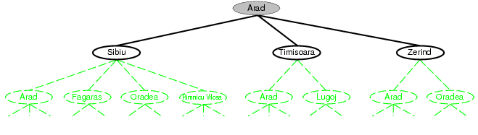
Tree search example: after expanding Arad

Slide 34
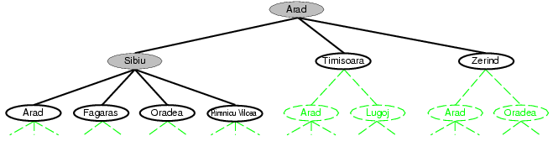
Tree search example: after expanding Sibiu

Slide 35
Measuring Problem-Solving Performance
Completeness: Is the algorithm guaranteed to find a solution when there is one?
Optimality: Does the strategy find the optimal solution?
Time complexity: How long does it take to find a solution?
Space complexity: How much memory is needed to perform the search?

Slide 36
Time and space complexity
Time and space complexity are measured in terms of
b: maximum branching factor (maximum number of successors) of the search tree
d: depth of the least-cost solution
m: maximum depth of the state space (may be ∞)

